Slide 1

J-Link Firmware Dump Dump , structure , validation
Mohammad Mazarei
sisoog.com
Notes:
ID=d924773e-9a16-4d6d-9803-8cb819e99682
Recipe=text_billboard
Type=TextOnly
Variant=0
FamilyID=AccentBoxWalbaum_Zero

Slide 2


Introduction
I am an Electronic and Embedded System Engineer with over 15 years of professional experience.
Have been in contact with exciting topics such as Electronics, Programming (mainly for Hardware) Embedded Linux, Real-time operating systems, Embedded systems, Sensors and telecommunication networks, IoT devices, etc
and co-founder of sisoog.com

Slide 3
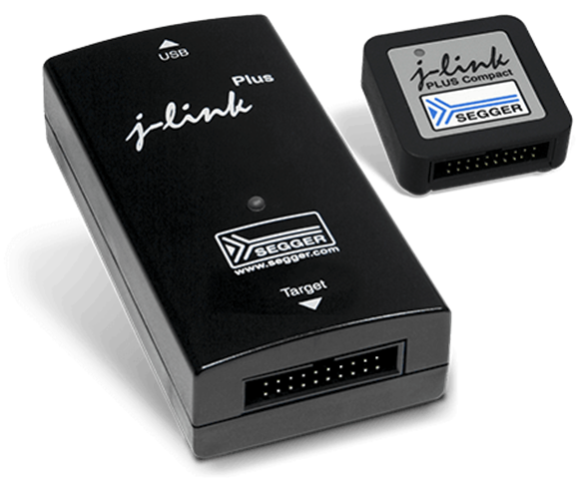
Waht is J-Link
sisoog.com
5

Slide 4

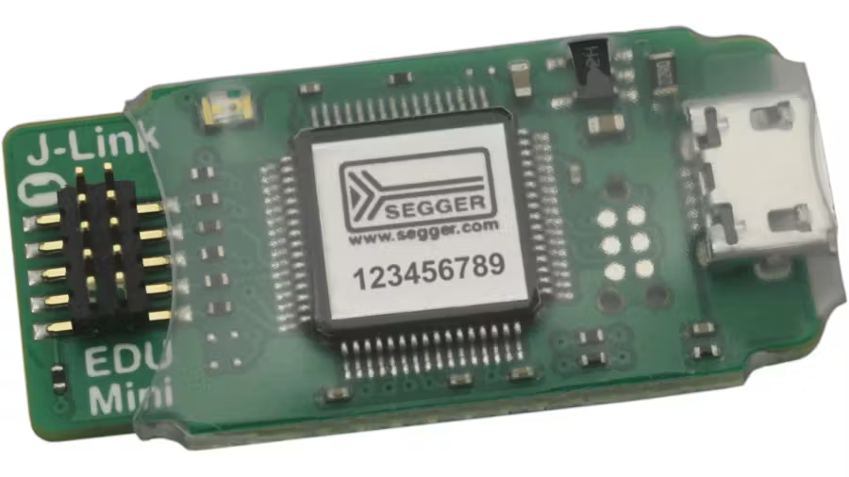
SEGGER J-Link
✅ Professional in-circuit programmer & debuggerfor MCUs/SoCs
✅ By SEGGER, supports ARM Cortex-M/A/R, RISC-V, and select others
✅ Debug interfaces: SWD, JTAG, cJTAG
✅ Cross-platform tools: J-Link Commander, GDB Server, J-Flash, RTT

Slide 5
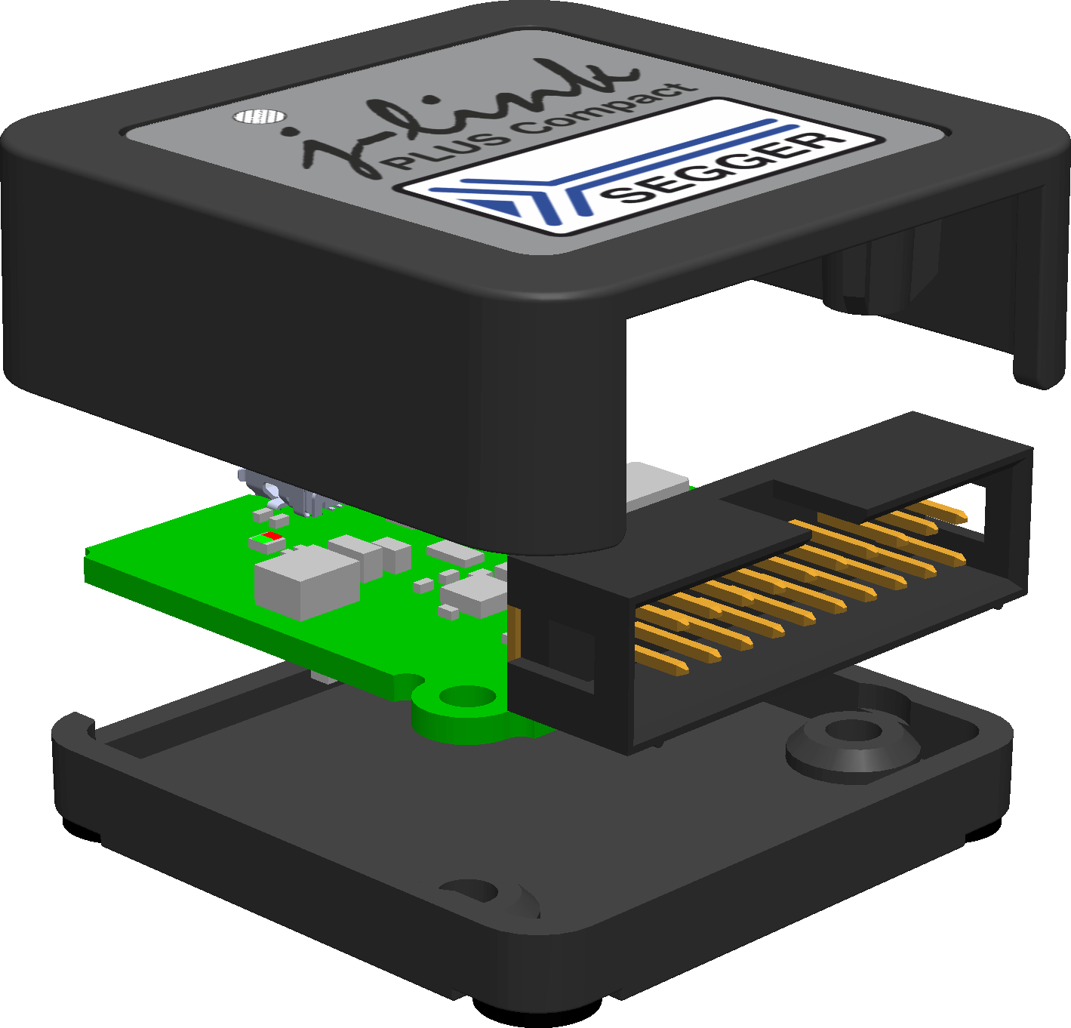
Why J-Link ?
🚀 Fast & stableflashing and halt/resume
🎯 Broad IDE compatibility(Keil, IAR, SEGGER ES, VS Code + GDB, …)
✅ RTT/SWO for high-speed logging without UART
♻️ Frequent firmware/device pack updates
✅ So many software package

Slide 6

Product Line at a Glance
✅ EDU / EDU Mini: for non-commercial use; core features for Cortex-M
✅ BASE / PLUS: general-purpose, solid speed & features
✅ ULTRA+ / PRO: higher speeds, larger buffers, advanced features
✅ J-Trace: hardware instruction trace (ETM)

Slide 7

History of hack
sisoog.com
7

Slide 8

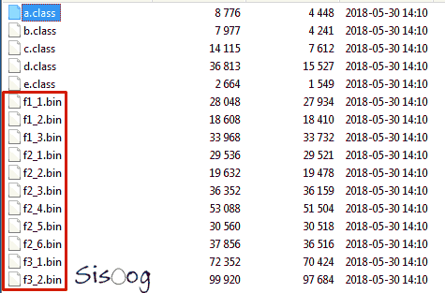
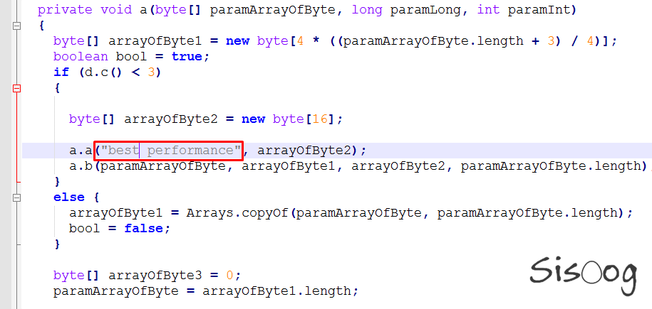
Hacking St-Link
✅ How to extract Firmware
😈 Find Key and decrypt Firmware
🔥 Hack Bootloader and load Custom rom

Slide 9

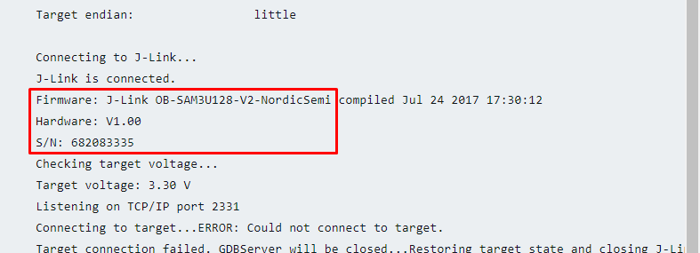
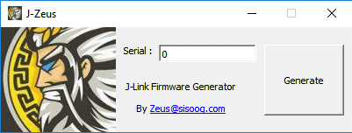
How to Save J-Link
🔥 Finding a credible series with social engineering
😈 Patching the firmware with the desired serial

Slide 10

How To Dump J-Link Firmware
sisoog.com
10

Slide 11
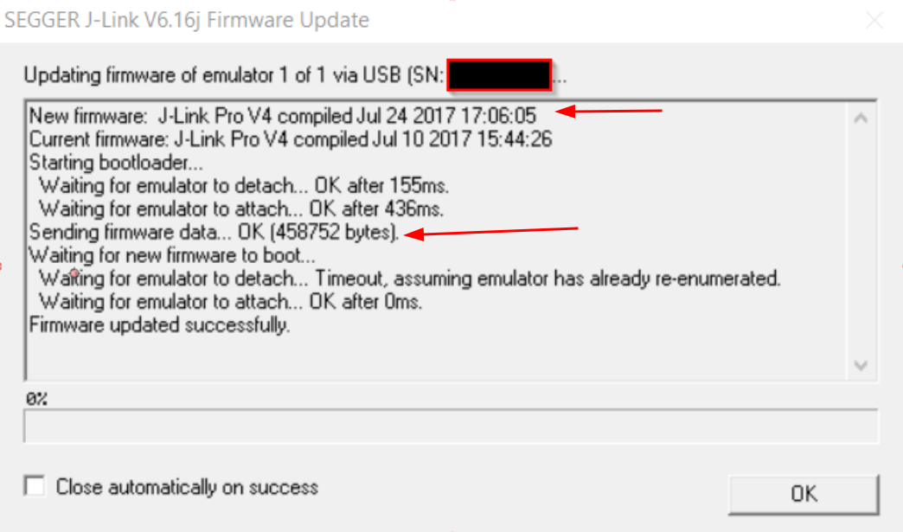
J-Link can Upgrade from USB
🚀 We can sniff USB !
But This way is hard
🎯 Probably firmware saved in
SEGGER J-Link path

Slide 12
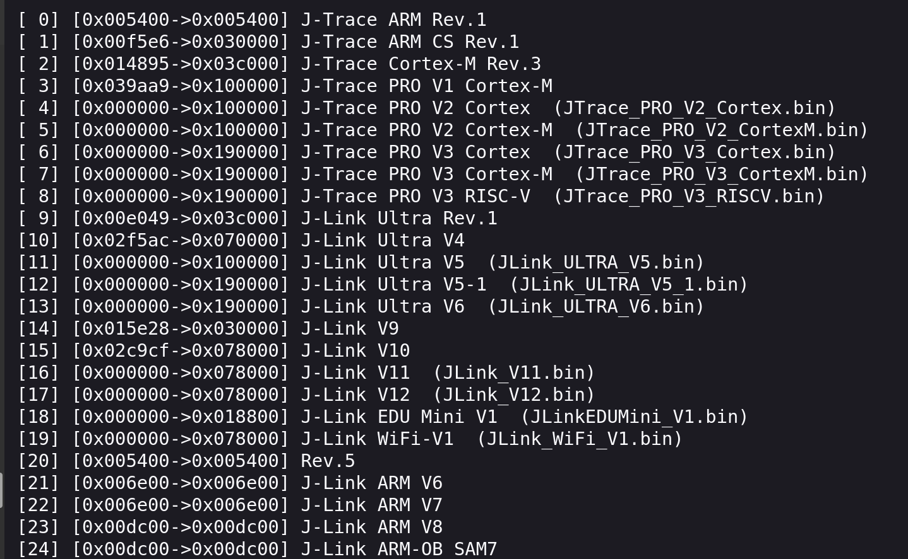
Look “libjlinkarm.so” library
🚀 Finding this table in the library was easy
🤕 unfortunately some of the firmwares are compressed/encrypted

Slide 13
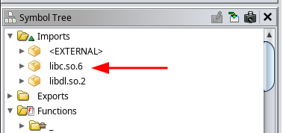

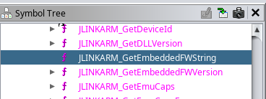
We Love OpenSource World :)

Slide 14
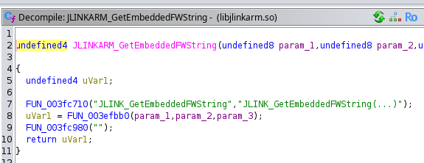
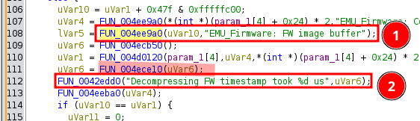
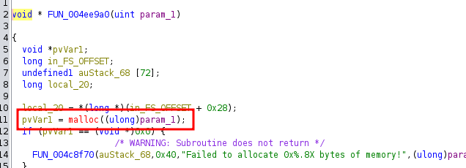
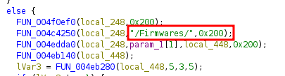
About JLINKARM_GetEmbeddedFWString()

Slide 15
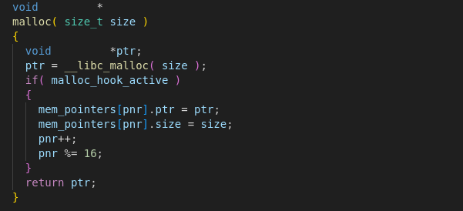
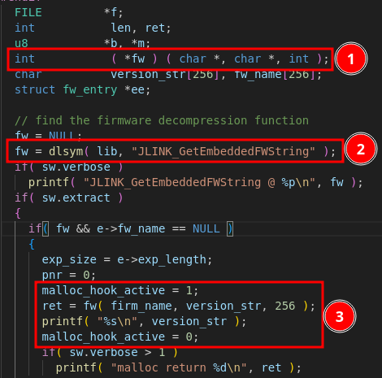
I love C & Linux
It’s Very Simple
1. make Simple C Programm
2. load libjlinkarm.so with dlopen
3. intercept ‘malloc’ founction
5. call ‘JLINK_GetEmbeddedFWString’ founction
6. dump the memory allocated by malloc

Slide 16
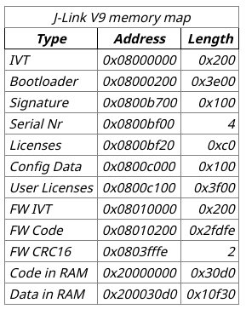
We have Problem (Bootloader)
It’s Simple
OTA firmware doesn’t have a Bootloader
FW without Bootloadr cannot run
💡Copy IVT Table from 0x8010000 To 0x8000000

Slide 17
How to extract bootloadr

Slide 18
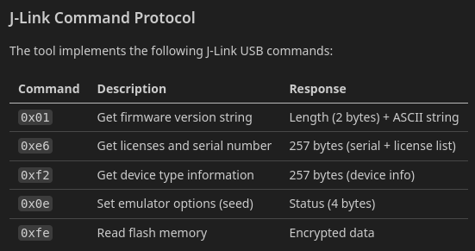
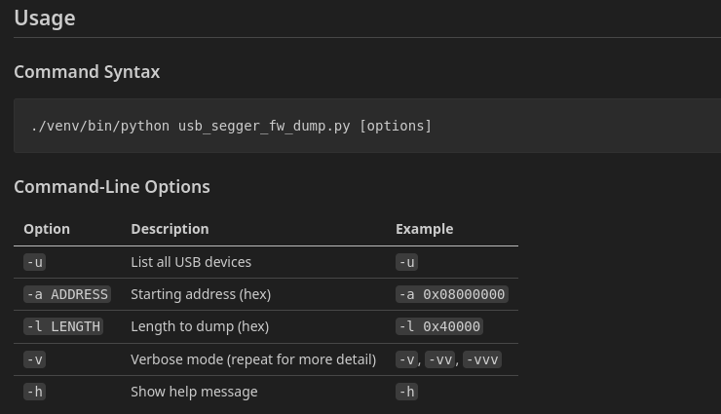
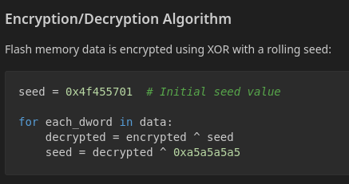
USB Segger fw dump

Slide 19

Thanks to Emil
https://uglyduck.vajn.icu/ep/

Slide 20




Thank you
Twitter.com/sisoog
t.me/sisoog
zeus@sisoog.com
www.sisoog.com
<number>

