Slide 1


Rust & Embedded Rust
A Safer Path to Programming
Morteza Norouzi

Slide 2



About me
I have two main fields of activity. Firstly, electrical engineering and secondly, computer engineering. My work in computer engineering is in line with the needs that have arisen from electronics. Over the past few years, depending on the circumstances, I have also participated in parts of leading technical teams and coordinating between teams, which has given me interesting experiences .
I tried to share my knowledge with others on www.nikelec.ir and www.digidore.com.
Contact :
linkedin.com/in/mortezaـnorouzi/
https://t.me/Mnorouzi72
mnorouziemail@gmail.com

Slide 3
Why new programming languages ?
Asking a more general question can help us here: Why do we need to create anything at all? In fact, if you look closely, "something" is not important "why" is important.
This is one of the most important considerations in the design, production, and creation of anything – whether it is a product, programming language, device, or something else . In the initial steps, you must identify a real need or problem and understand it. Based on that, and after extensive research, you can say that in a phase of a build, you present the solution. This solution may include specific values. Therefore, if something has been developed according to principles, it will provide a useful answer to one or more needs.

Slide 4
Why new programming languages ?
In the process of creating something – such as a programming language – you often encounter existing solutions, and that need may already be addressed in some way. Sometimes you discover something new, but in any case, it is necessary to specify the need you are addressing and clearly define your solution.
Programming languages are created in the same way. However, some important questions arise: Was the need discovered or identified correctly? There are different methods to determine this, but in most cases, you will see that new creations fail. Do you know how many programming languages have been created so far?

Slide 5
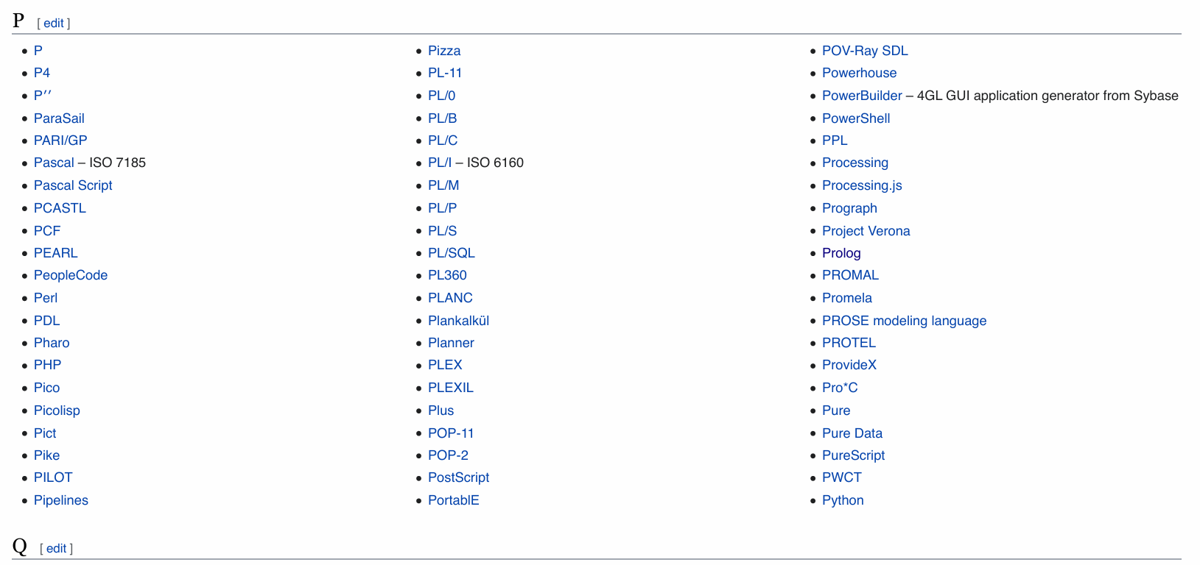
Why new programming languages ?
Some sources say more than 8,000, and you can easily see more than 1,000 listed on Wikipedia.

Slide 6
Why new programming languages ?
How many of them have you even heard about?
Python, PHP, Perl, Pascal
There are fewer than 25 you can probably name . The real question here is: Why should we create another language?
Just as with designing and producing a product, you must correctly understand the need to ensure that what you offer is accepted rather than rejected. So, let us take a moment to check the status of Rust and see whether it was accepted by those who needed it.

Slide 7
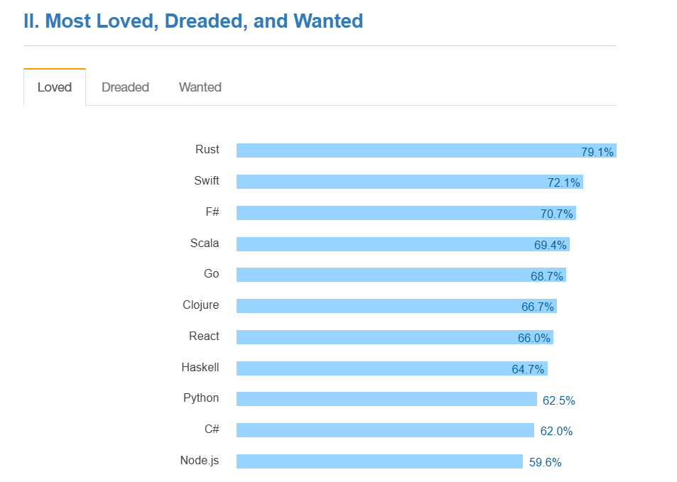
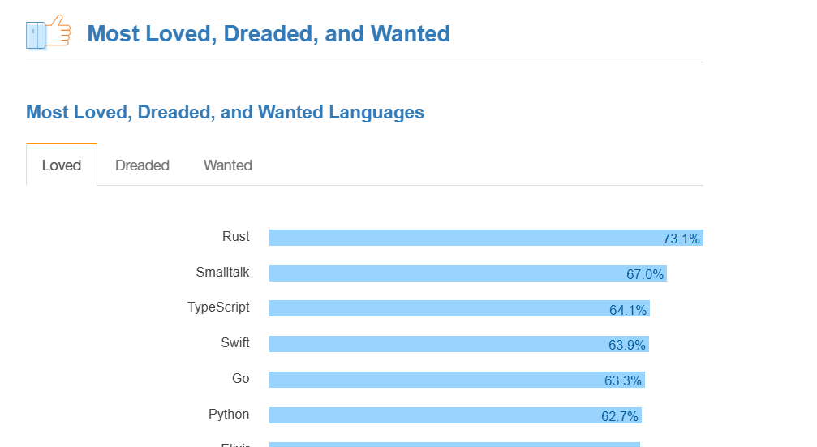
Was Rust Fit for the needs it was created for?
Stack Overflow Developer Survey 2016 / 2017

Slide 8

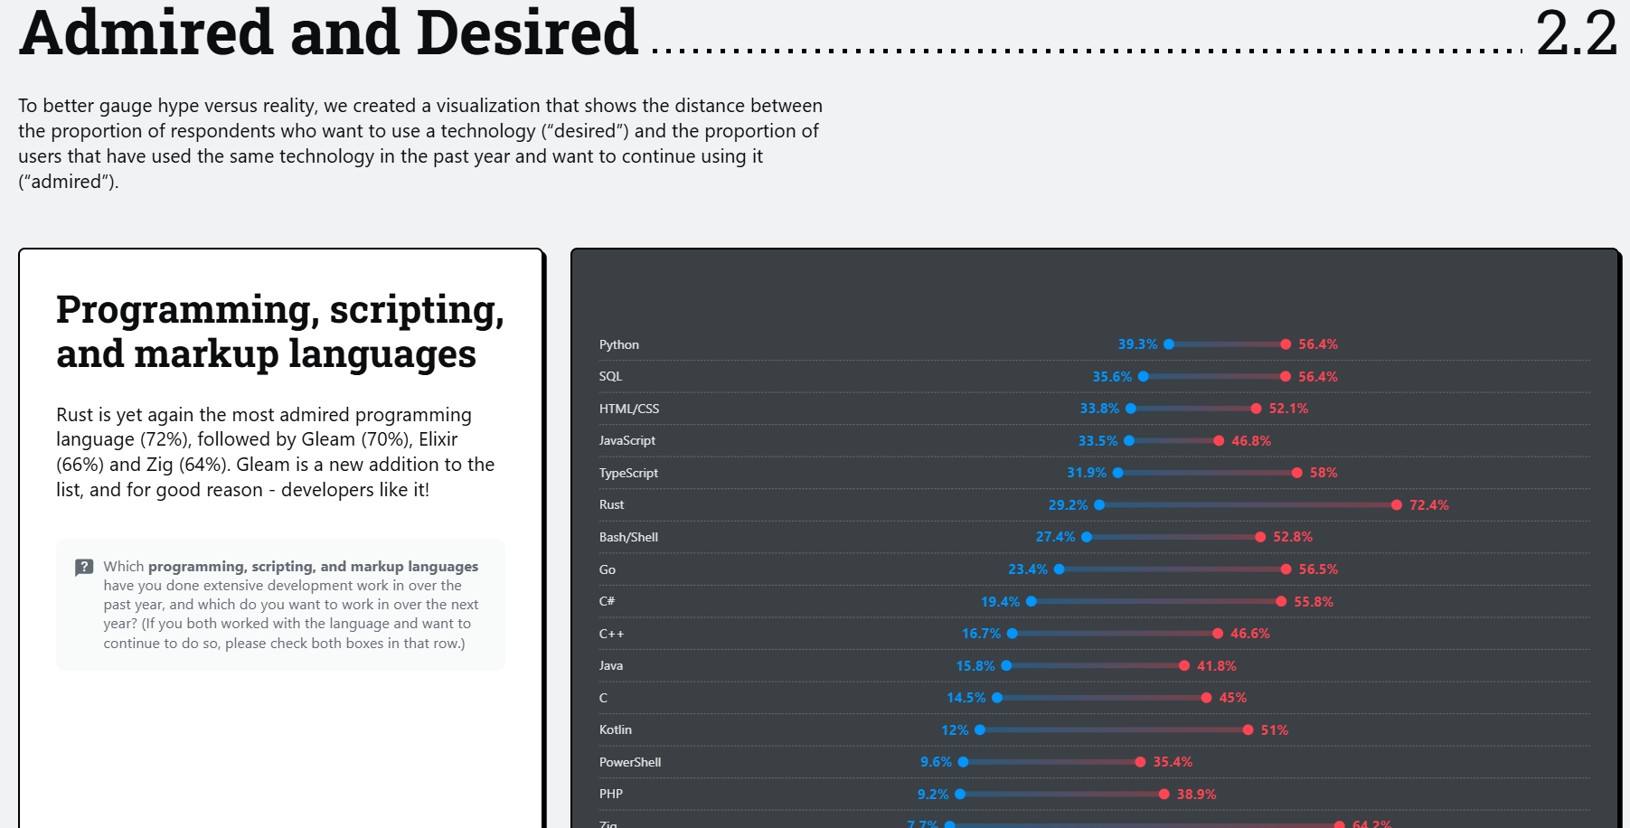
Was Rust Fit for the needs it was created for?
Technology | 2025 Stack Overflow Developer Survey
2025: Rust is yet again the most admired programming language (72%), followed by Gleam (70%), Elixir (66%) and Zig (64%). Gleam is a new addition to the list, and for good reason - developers like it!

Slide 9

Was Rust Fit for the needs it was created for?

Slide 10
Lets dig into it !
It seems they understood the need well, and the value they provided was good. So, what need or needs did they address, and what value did they provide? We can start with one of the most important issues in programming languages: memory safety. It claims to guarantee this when you use stable. What is this issue, and how important is it?

Slide 11


Slide 12
Defining Memory Safety Bugs :
Memory safety bugs arise when a program allows statements to execute that read or write memory, when the program is in a state where the memory access constitutes undefined behavior. When such a statement is reachable in a program state under adversarial control (e.g., processing untrusted inputs), the bug often represents an exploitable vulnerability (in the worst case, permitting arbitrary code execution).

Slide 13
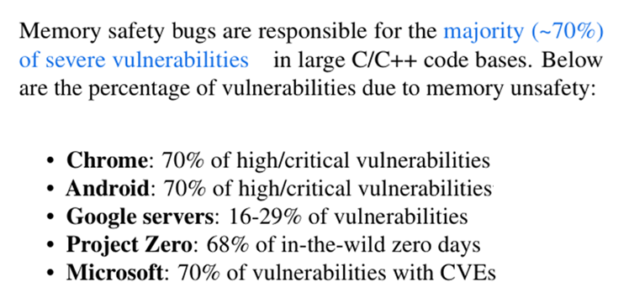
Defining Memory Safety Bugs :

Slide 14
Understanding Memory Safety Bugs
It can be helpful to distinguish a number of subclasses of memory safety bugs that differ in their possible solutions and the impact on performance and developer experience thereof:
• Spatial Safety bugs (e.g. “buffer overflow”, “out of bounds access”) occur when a memory access refers to memory outside of the accessed object’s allocated region.
• Temporal Safety bugs arise when a memory access to an object occurs outside of the object’s lifetime. An example is when a function returns a pointer to a value in its stack frame (“use-after-return”), or due to a pointer to heap allocated memory that has since been freed, and possibly re-allocated for a different object (“use-after-free”). It is common in concurrent programs for these bugs to occur due to improper thread synchronization, but when the initial safety violation is outside of the lifetime of the object, we classify it as a temporal safety violation.

Slide 15
Understanding Memory Safety Bugs
• Type Safety bugs arise when a value of a given type is read from memory that does not contain a member of this type. An example of this is when memory is read after an invalid pointer cast.
• Initialization Safety bugs arise when memory is read before being initialized. This can lead to information disclosures and type/temporal safety bugs.
• Data-Race Safety bugs arise from unsynchronized reads and writes by different threads, which may access an object in an inconsistent state. It is possible for other forms of safety bugs to also arise from improper or missing synchronization, however we do not classify these as data race safety bugs and they are handled above. Only when the reads and writes are otherwise correct except for being unsynchronized are they considered data-race safety bugs. Once a data-race safety violation has occurred, subsequent execution may cause further safety bugs. We classify these as data-race safety bugs as the initial violation is strictly a data-race issue without any other bugs evident. The classification used here roughly aligns with Apple’s memory safety taxonomy .

Slide 16
Understanding Memory Safety Bugs
In unsafe languages such as C/C++, it is the programmer’s responsibility to ensure the safety preconditions are met to avoid accessing invalid memory. For instance, for spatial safety, when accessing elements of an array via index (e.g., a[i] = x), it is the programmer’s responsibility to ensure the safety precondition that the index is within the bounds of validly allocated memory

Slide 17
Understanding Memory Safety Bugs
In Rust, memory-unsafe code is clearly delineated and confined to unsafe blocks . Rust is a type-safe language.
Safe Rust enforces that all values are initialized, and ensures spatial safety by adding bounds checks where necessary. Dereferencing a raw pointer is not allowed in safe Rust. Rust is the only mature, production-ready language that pro vides temporal safety without run-time mechanisms such as

Slide 18
Understanding Memory Safety Bugs
Garbage collection or universally-applied refcounting, for large classes of code.
Rust provides temporal safety through compile time checks on the lifetimes of variables and references.
The constraints imposed by the borrow checker preclude the implementation of certain structures, in particular those involving cyclic reference graphs.
The Rust standard library includes APIs that allow such structures to be implemented safely, but with runtime overhead (based on reference counting).
In addition to memory safety, Rust’s safe subset also guarantees data-race safety (“Fearless Concurrency ”). Incidentally, data-race safety allows Rust to safely avoid unnecessary over head when using runtime temporal safety mechanisms: Both Rc and Arc implement reference-counted pointers. However, Rc’s type precludes it from being shared across threads, so Rc can safely use a cheaper, non-atomic counter.

Slide 19

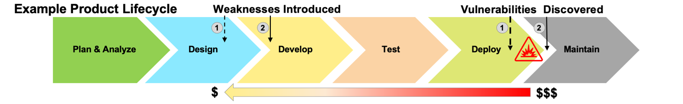
Common Weakness Enumeration (CWE™) is a community-developed list of common software and hardware weaknesses. A “weakness” is a condition in a software, firmware, hardware, or service component that, under certain circumstances, could contribute to the introduction of vulnerabilities. The CWE List and associated classification taxonomy identify and describe weaknesses in terms of CWEs.
Knowing the weaknesses that result in vulnerabilities means software developers, hardware designers, and security architects can eliminate them before deployment, when it is much easier and cheaper to do so.

Slide 20
The CWE Top 25 can help inform:
Vulnerability Reduction – Insights into the common root causes drive valuable feedback into vendors’ SDLC and architectural planning, helping to eliminate entire classes of defect (e.g., memory safety, injection)
Cost Savings – Fewer vulnerabilities in product development mean fewer issues to manage post-deployment, ultimately saving money and resources
Trend Analysis – Insight into data trends enables organizations to better focus security efforts
Exploitability Insights – Certain weaknesses such as command injection attract adversarial attention, enabling risk prioritization.
Customer Trust – Transparency in how organizations address these weaknesses shows commitment to product security

Slide 21
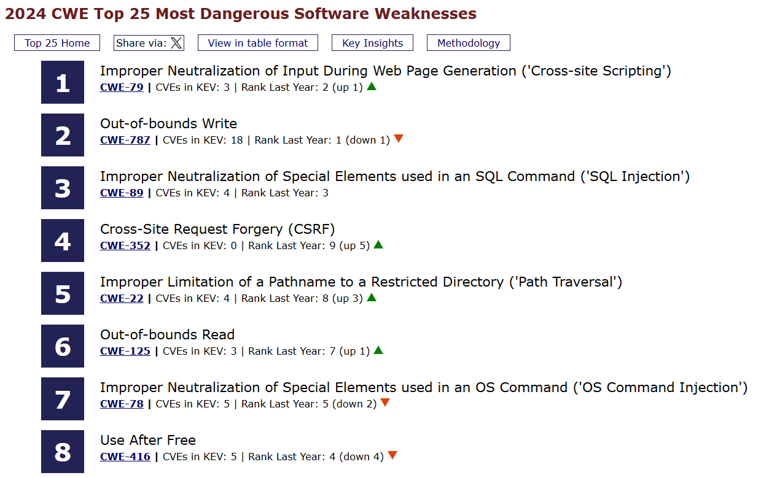
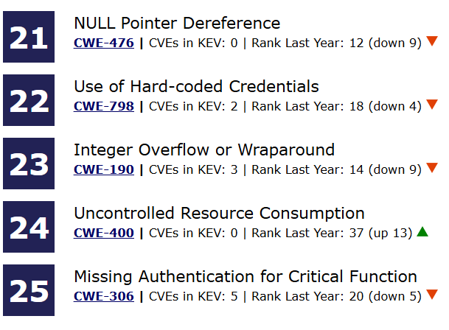
Top 25 CWE :

Slide 22

The latest news and insights from Google on security and safety on the Internet
Rust in the Android platform
Correctness of code in the Android platform is a top priority for the security, stability, and quality of each Android release. Memory safety bugs in C and C++ continue to be the most-difficult-to-address source of incorrectness.
Unfortunately, for the lower layers of the OS, Java and Kotlin are not an option.
For C and C++, the developer is responsible for managing memory lifetime. Unfortunately, it's easy to make mistakes when doing this, especially in complex and multithreaded codebases.
Rust provides memory safety guarantees by using a combination of compile-time checks to enforce object lifetime/ownership and runtime checks to ensure that memory accesses are valid. This safety is achieved while providing equivalent performance to C and C++.

Slide 23
Rust in the Android platform
Memory-safe languages like Rust help us overcome these limitations in two ways:
Lowers the density of bugs within our code, which increases the effectiveness of our current sandboxing.
Reduces our sandboxing needs, allowing introduction of new features that are both safer and lighter on resources.
Prioritizing prevention
Rust modernizes a range of other language aspects, which results in improved correctness of code:
Memory safety - enforces memory safety through a combination of compiler and run-time checks.
Data concurrency - prevents data races. The ease with which this allows users to write efficient, thread-safe code has given rise to Rust’s Fearless Concurrency slogan.
More expressive type system-References and variables are immutable by default-Better error handling in standard libraries -Initialization-Safer integer handling

Slide 24
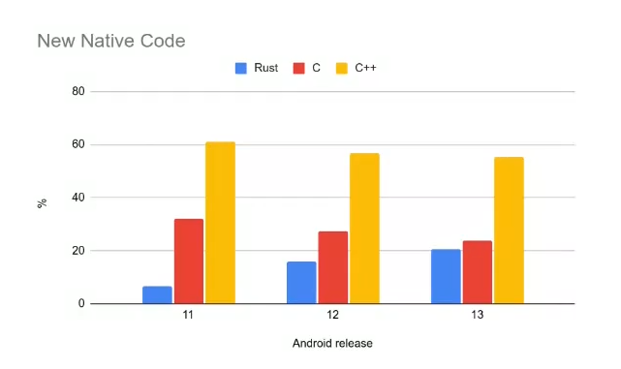

Rust in the Android platform

Slide 25

A proactive approach to more secure code
Since 2004, the Microsoft Security Response Centre (MSRC) has triaged every reported Microsoft security vulnerability. From all that triage one astonishing fact sticks out: as Matt Miller discussed in his 2019 presentation at BlueHatIL, the majority of vulnerabilities fixed and with a CVE assigned are caused by developers inadvertently inserting memory corruption bugs into their C and C++ code.
If only the developers could have all the memory security guarantees of languages like .NET C# combined with all the efficiencies of C++. Maybe we can: One of the most promising newer systems programming languages that satisfy those requirements is the Rust programming language originally invented by Mozilla.

Slide 26

Rust for Linux
Rust for Linux is an ongoing project started in 2020 to add Rust as a programming language that can be used within the Linux kernel software, which has been written using C and assembly only. This project aims to leverage Rust's memory safety to reduce bugs when writing kernel drivers. Progress has been slower than hoped by both Rust advocates and Linus Torvalds, lead of the Linux kernel project. In December 2023, the first drivers written in Rust were accepted, and released in version 6.8.

Slide 27

Time to Shine!

Slide 28
Time to Shine !
Something does not seem right. If memory safety is the only requirement, then another language could claim to provide it as well. For example, Kotlin – so why is Rust being chosen? This is where the art and beauty of Rust become apparent. Languages like Java, Python, or others that use GC (apart from the fact that garbage collection itself can have memory management issues in certain scenarios) require a subsystem, such as the JVM, to run alongside the programs. The beauty of Rust is that it achieves this without any external dependencies and even at compile time, using Ownership and the Borrow Checker. Furthermore, Rust is not limited to just this important feature. Exciting things are coming...

Slide 29
Time to Shine : Is It OOP ?
Objects Contain Data and Behavior
The book Design Patterns: Elements of Reusable Object-Oriented Software by Erich Gamma, Richard Helm, Ralph Johnson, and John Vlissides (Addison-Wesley, 1994), colloquially referred to as The Gang of Four book, is a catalog of object-oriented design patterns. It defines OOP in this way:
Object-oriented programs are made up of objects. An object packages both data and the procedures that operate on that data. The procedures are typically called methods or operations.
Using this definition, Rust is object oriented: structs and enums have data, and impl blocks provide methods on structs and enums. Even though structs and enums with methods aren’t called objects, they provide the same functionality, according to the Gang of Four’s definition of objects.

Slide 30
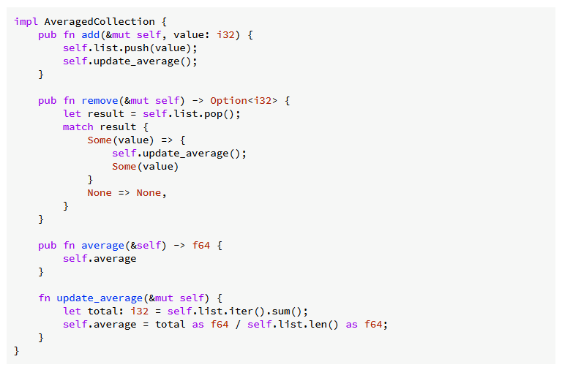
Time to Shine : Is It OOP ?
Encapsulation That Hides Implementation Details
Another aspect commonly associated with OOP is the idea of encapsulation, which means that the implementation details of an object aren’t accessible to code using that object.

Slide 31
Time to Shine : Is It OOP ?
Inheritance as a Type System and as Code Sharing
Inheritance is a mechanism whereby an object can inherit elements from another object’s definition, thus gaining the parent object’s data and behavior without you having to define them again.
If a language must have inheritance to be object oriented, then Rust is not such a language. There is no way to define a struct that inherits the parent struct’s fields and method implementations without using a macro.
However, if you’re used to having inheritance in your programming toolbox, you can use other solutions in Rust, depending on your reason for reaching for inheritance in the first place.
You would choose inheritance for two main reasons. One is for reuse of code: you can implement particular behavior for one type, and inheritance enables you to reuse that implementation for a different type. You can do this in a limited way in Rust code using default trait method

Slide 32
Time to Shine : Is It OOP ?
Polymorphism
To many people, polymorphism is synonymous with inheritance. But it’s actually a more general concept that refers to code that can work with data of multiple types. For inheritance, those types are generally subclasses.
Rust instead uses generics to abstract over different possible types and trait bounds to impose constraints on what those types must provide. This is sometimes called bounded parametric polymorphism.

Slide 33
Time to Shine : Is It OOP ?
Regardless of whether you think Rust is an object-oriented language after reading this chapter, you now know that you can use trait objects to get some object-oriented features in Rust. Dynamic dispatch can give your code some flexibility in exchange for a bit of runtime performance. You can use this flexibility to implement object-oriented patterns that can help your code’s maintainability. Rust also has other features, like ownership, that object-oriented languages don’t have. An object-oriented pattern won’t always be the best way to take advantage of Rust’s strengths, but it is an available option.

Slide 34
Time to Shine : Functional Language Features
Iterators and Closures
Rust’s design has taken inspiration from many existing languages and techniques, and one significant influence is functional programming. Programming in a functional style often includes using functions as values by passing them in arguments, returning them from other functions, assigning them to variables for later execution, and so forth.
Closures, a function-like construct you can store in a variable
Iterators, a way of processing a series of elements

Slide 35

Time to Shine : The Cargo !
Cargo is the Rust package manager.
Cargo downloads your Rust package’s dependencies,
compiles your packages, makes distributable packages,
and uploads them to crates.io,
the Rust community’s package registry.

Slide 36
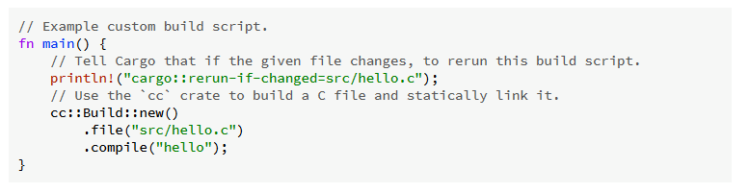
Time to Shine : The Cargo !
Build Scripts
Some packages need to compile third-party non-Rust code, for example
C libraries. Other packages need to link to C libraries which can either
be located on the system or possibly need to be built from source.
Others still need facilities for functionality such as code generation before building (think parser generators).
Cargo does not aim to replace other tools that are well-optimized for these tasks, but it does integrate with them with custom build scripts. Placing a file named build.rs in the root of a package will cause Cargo to compile that script and execute it just before building the package.

Slide 37

Time to Shine : The Cargo !
Some example use cases of build scripts are:
- Building a bundled C library.
- Finding a C library on the host system.
- Generating a Rust module from a specification.
- Performing any platform-specific configuration needed for the crate.
The [features] section
Features are defined in the [features] table in Cargo.toml.
Each feature specifies an array of other features or optional dependencies that it enables.
The following examples illustrate how features could be used for a 2D image processing library where support for different image formats can be optionally included

Slide 38
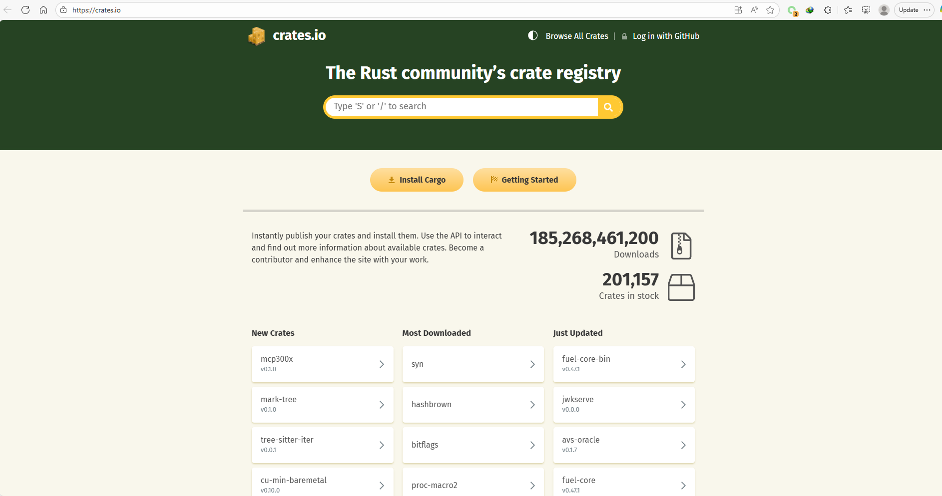
Time to Shine : Crates.io

Slide 39
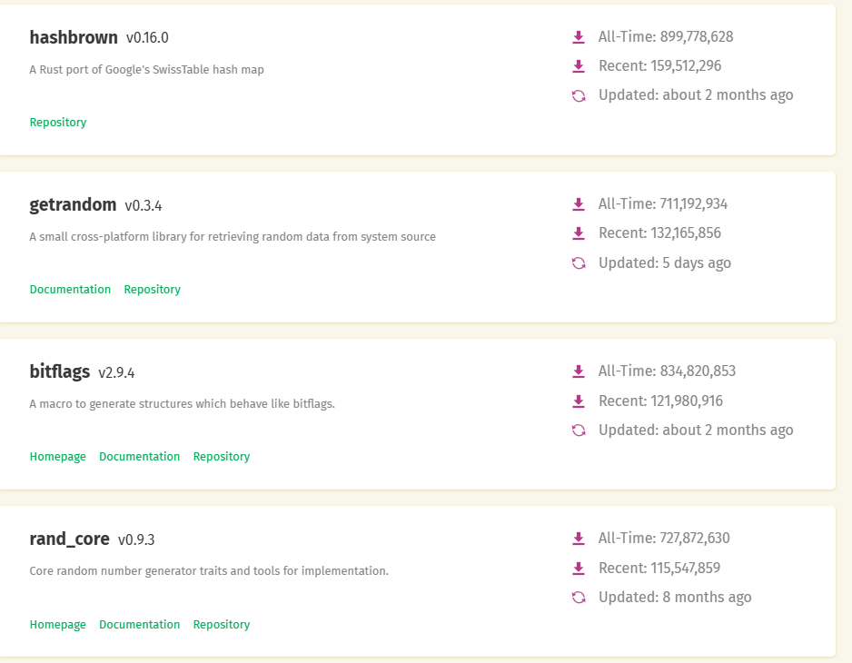
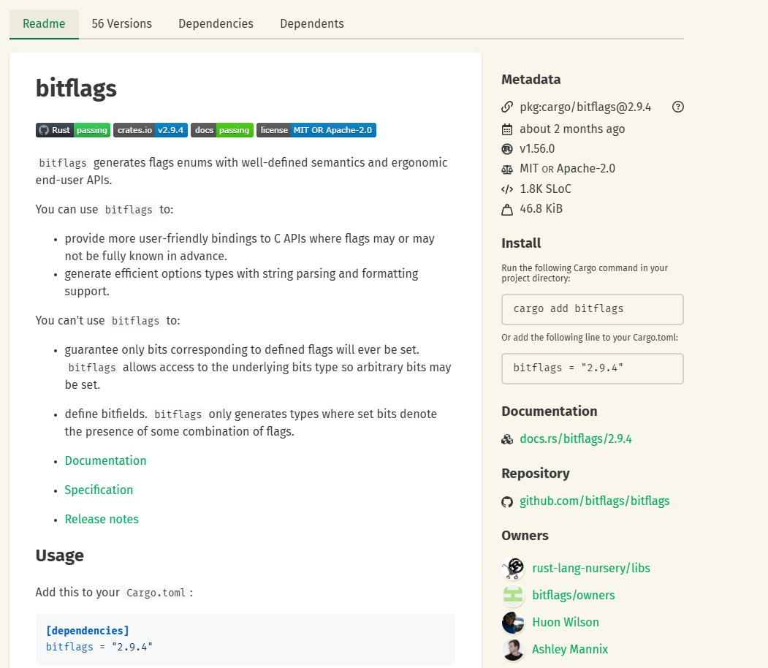
Time to Shine : Crates.io

Slide 40

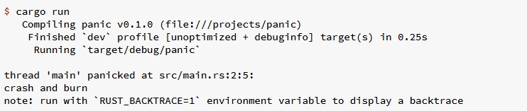
Time to Shine : Error Handling
Do not fight with the compiler; it is there to help you – it is not your enemy!
Rust wants you to succeed:
- Rules catch things that appear unsafe.
- The unsafe directive is an override.
- Errors deserve helpful documentation.

Slide 41
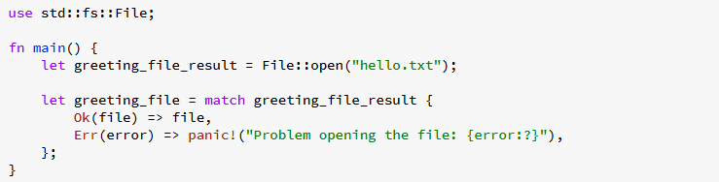
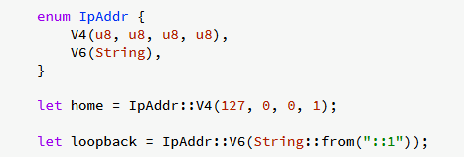
Fancy Time : Enums

Slide 42
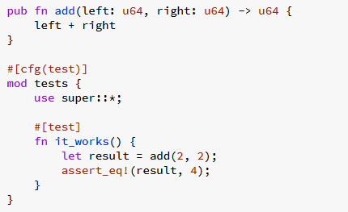
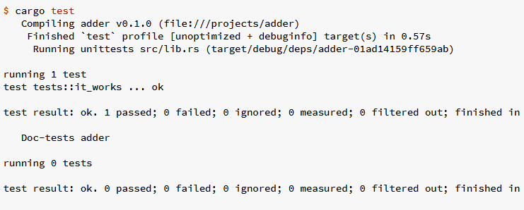
Time to Shine : Testing
Software testing is the act of checking whether software satisfies expectations.
Software testing can provide objective, independent information about the quality of software and the risk of its failure to a user or sponsor.

Slide 43
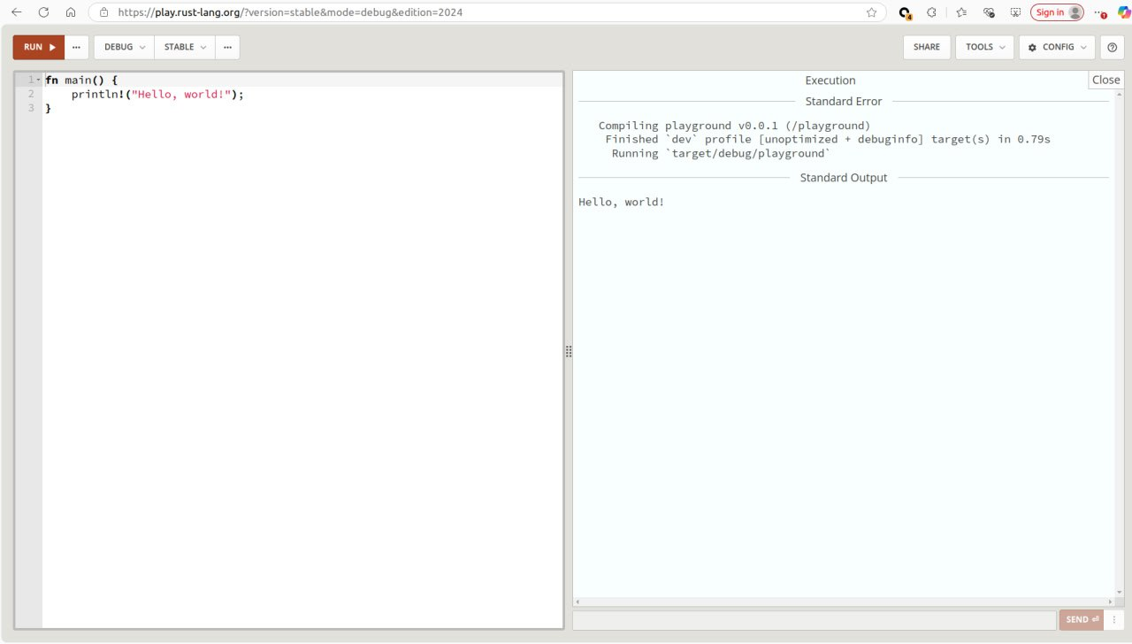
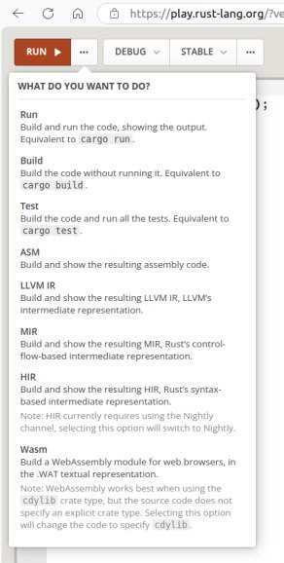
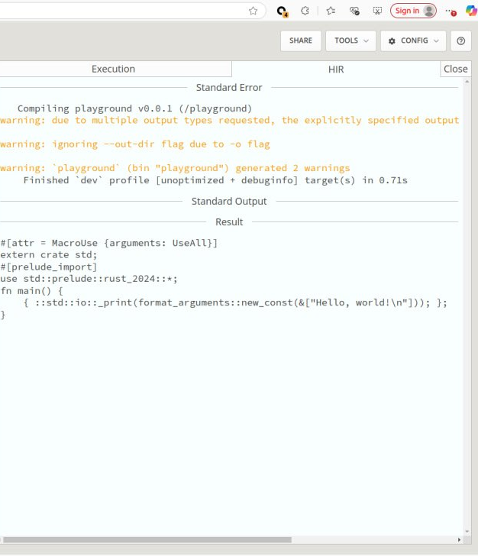
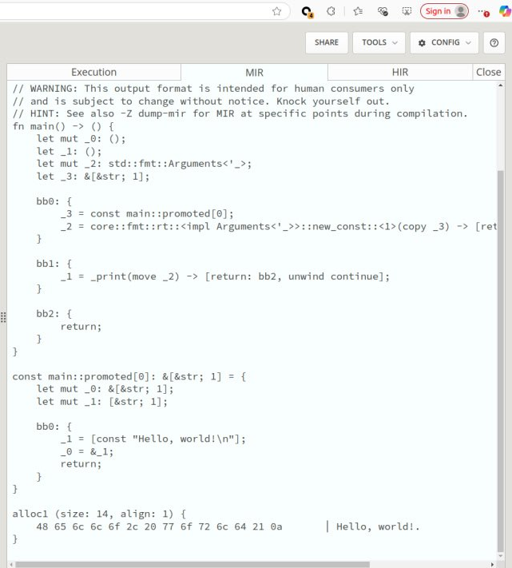
Time to Shine : play.rust-lang.org
If you want to learn how Rust works without any installation,

Slide 44

Time to Shine : And many more …
- Automatic Formatting with rustfmt : The rustfmt tool reformats your code according to the community code style
- More Lints with Clippy : The Clippy tool is a collection of lints to analyze your code so you can catch common mistakes and improve your Rust code. Clippy is included with standard Rust installations.
-IDE Integration Using rust-analyzer : To help IDE integration, the Rust community recommends using rust-analyzer. This tool is a set of compiler-centric utilities that speaks the Language Server Protocol, which is a specification for IDEs and programming languages to communicate with each other.
-Binary Related Tools
-Offline rust
-No-std
-FFI
-Bindgens
-RFC
-Unsafe {} : Are you sure you need it? I think you just need expert help if you are not sure what you are doing. Usually, it is not what you want.

Slide 45



Other Usage
Imagine a team where all stacks use the same programming language!

Slide 46

Embedded Rust
Powerful static analysis
Enforce pin and peripheral configuration at compile time. Guarantee that resources won’t be used by unintended parts of your application.
Flexible memory
Dynamic memory allocation is optional. Use a global allocator and dynamic data structures. Or leave out the heap altogether and statically allocate everything.
Fearless concurrency
Rust makes it impossible to accidentally share state between threads. Use any concurrency approach you like, and you’ll still get Rust’s strong guarantees.
Interoperability
Integrate Rust into your existing C codebase or leverage an existing SDK to write a Rust application.
Portability
Write a library or driver once, and use it with a variety of systems, ranging from very small microcontrollers to powerful SBCs.
Community driven
As part of the Rust open source project, support for embedded systems is driven by a best-in-class open source community, with support from commercial partners

Slide 47





Device specific communities
nrf-rs: Nordic nRF series of microcontrollers
stm32-rs: STM32 microcontrollers
lpc-rs: NXP LPC microcontrollers
imxrt-rs: NXP i.MX RT microcontrollers
esp-rs: Espressif Systems microcontrollers
rp-rs: Raspberry Pi microcontrollers including the RP2040

Slide 48
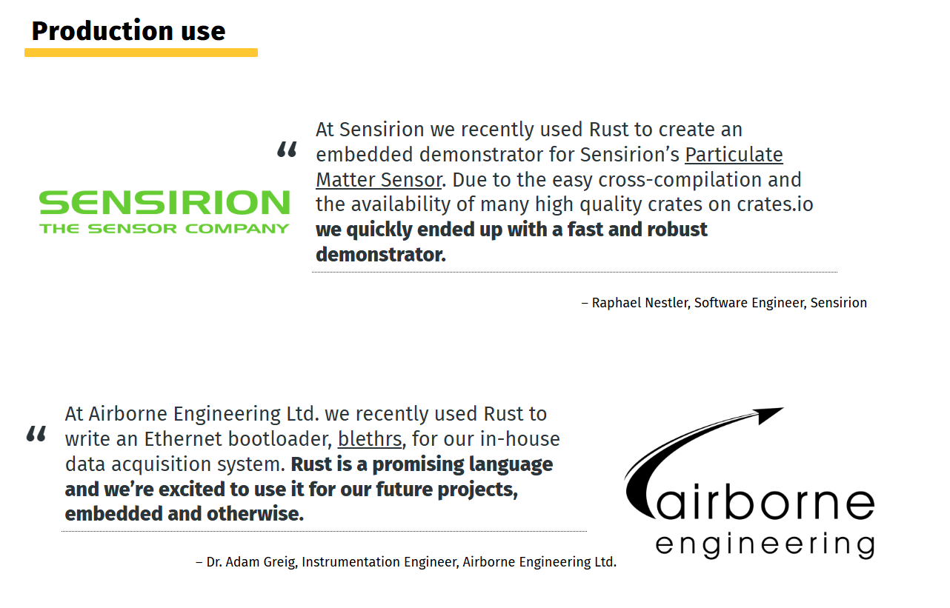
Device specific communities

Slide 49

Thank you
linkedin.com/in/mortezaـnorouzi/
https://t.me/Mnorouzi72
mnorouziemail@gmail.com

