Slide 1
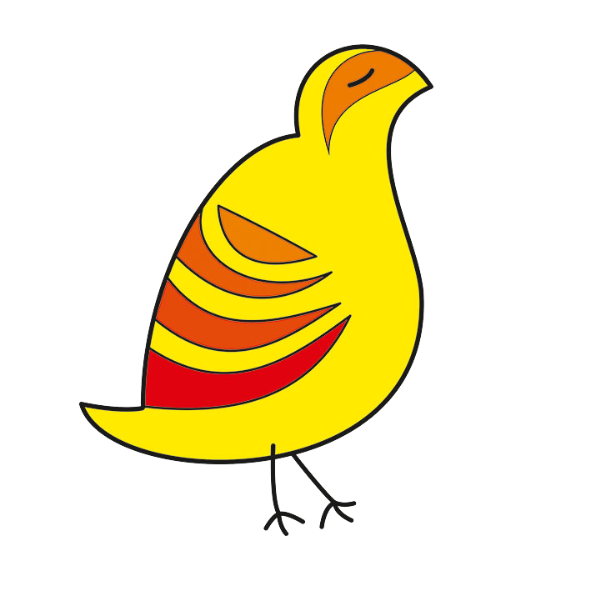
Break into the car's black box
Mohammad Mazarei
sisoog.com
Notes:
ID=d924773e-9a16-4d6d-9803-8cb819e99682
Recipe=text_billboard
Type=TextOnly
Variant=0
FamilyID=AccentBoxWalbaum_Zero

Slide 2
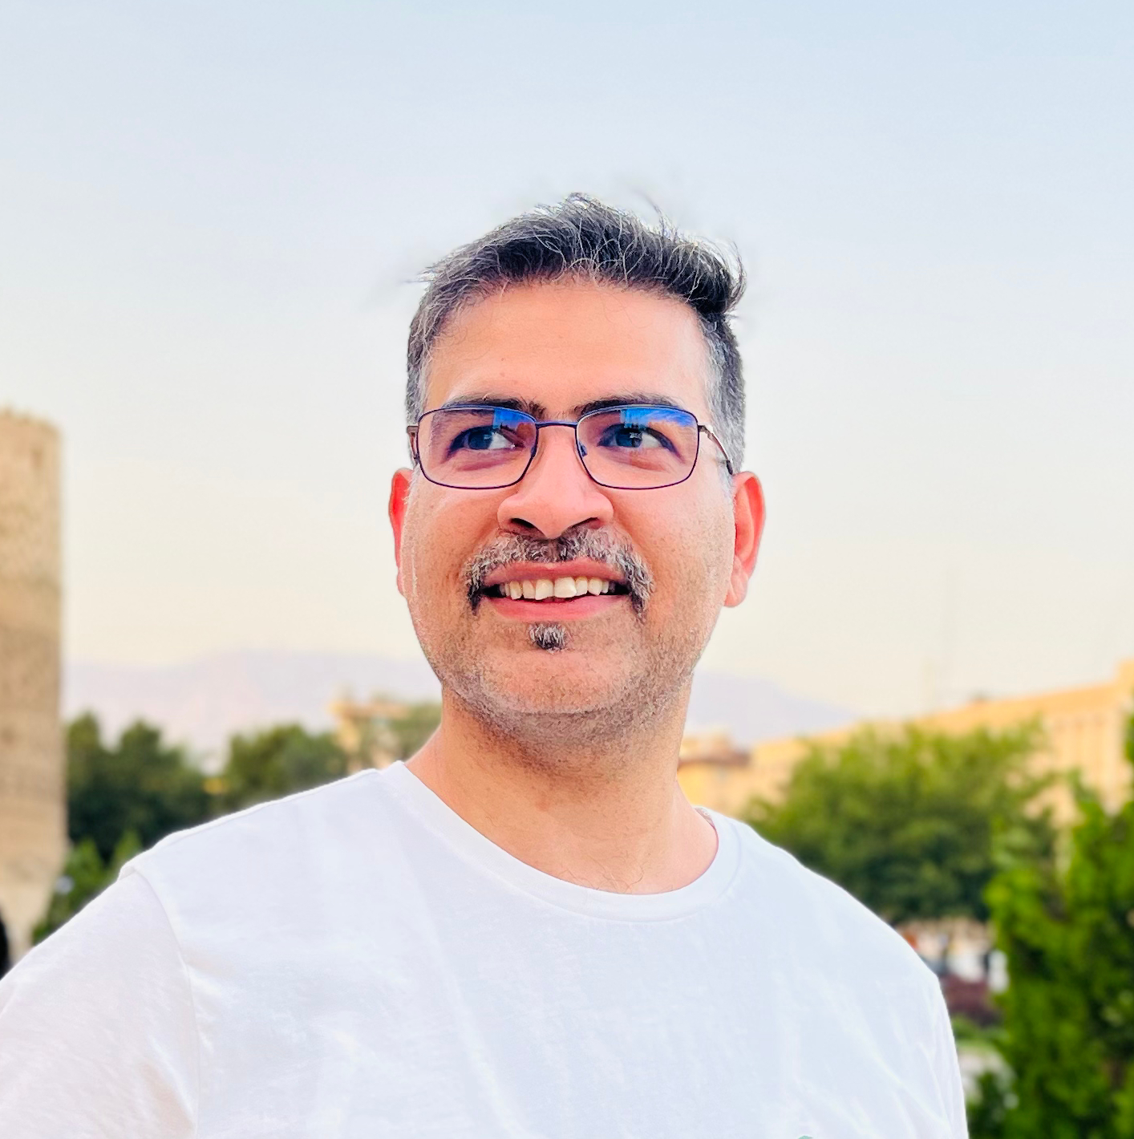
Introduction
I am an Electronic and Embedded System Engineer with over 10 years of professional experience.
Have been in contact with exciting topics such as Electronics, Programming (mainly for Hardware) Embedded Linux, Real-time operating systems, Embedded systems, Sensors and telecommunication networks, IoT devices, etc
and co-founder of sisoog.com

Slide 3
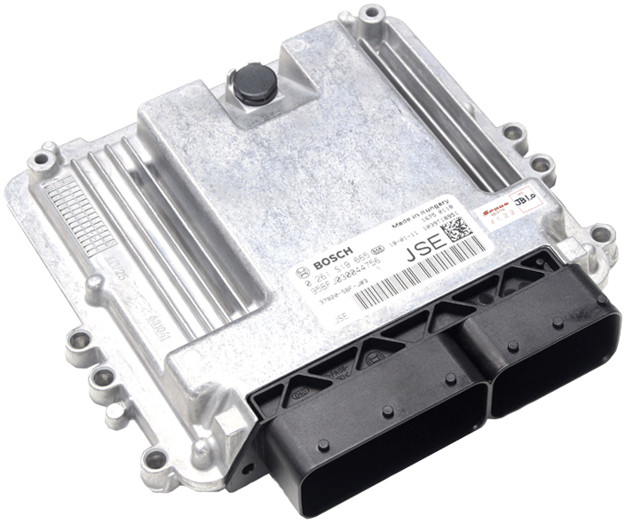
What is cars Black Box
sisoog.com
5

Slide 4
History of of Engine Control Units(ECU)
Early Mechanical Systems(Pre-1970s)
Pneumatic and mechanical systems were used to regulate engine characteristics before the introduction of electronic controls.
First Generation ECUs(1970s)
The first ECUs were introduced as a result of the oil crisis and rising environmental concerns.
Second Generation ECUs(1980s)
Advances in microprocessor technology enabled ECUs to integrate control over ignition timing, fuel injection, and other factors, resulting in improved fuel efficiency and performance management.
Third Generation ECUs(1990s to Present)
The ECUs of today are very complicated. They enable real-time optimization and flexibility by integrating with other vehicle
systems and managing almost every element of engine operation.

Slide 5
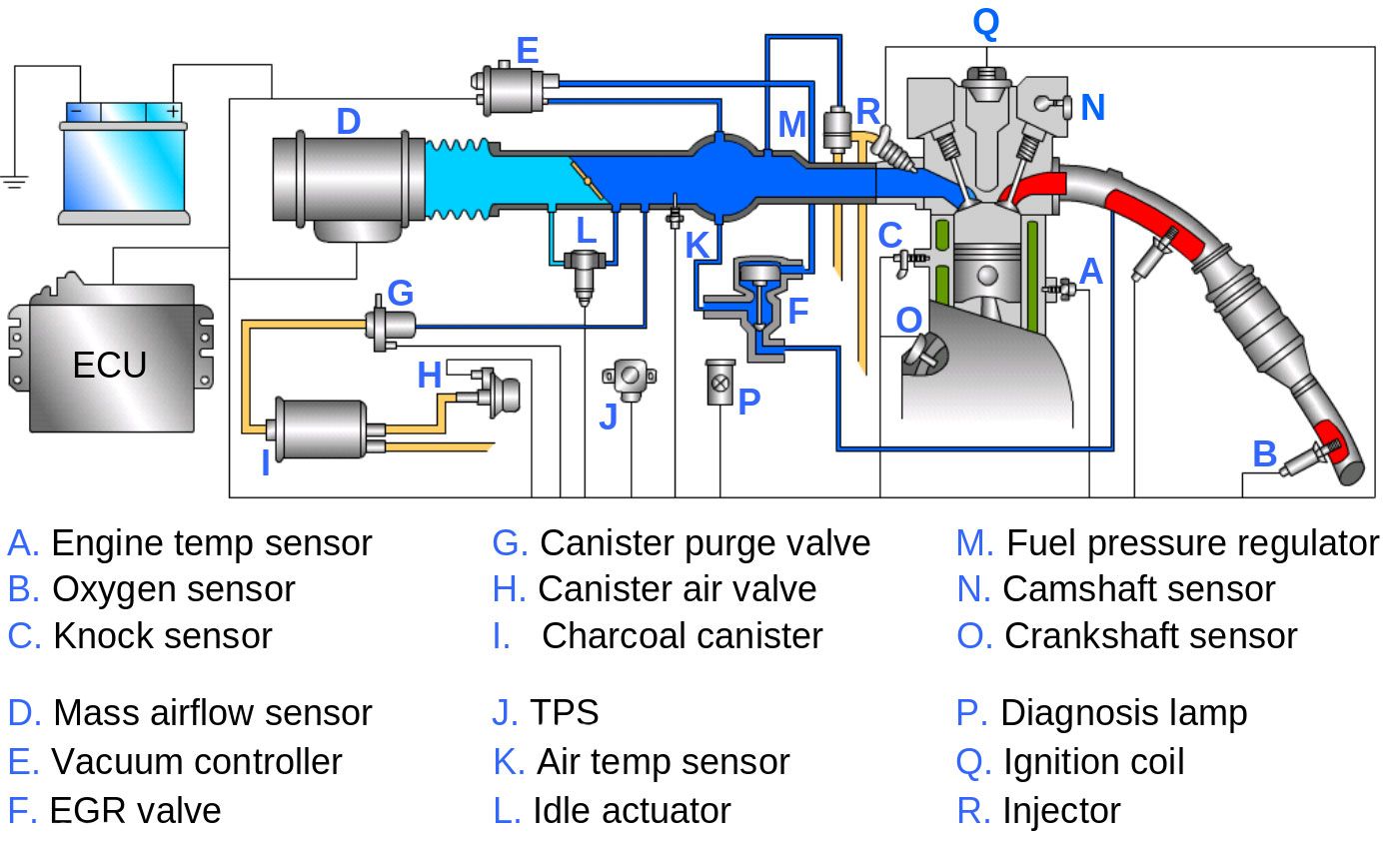
Simplified ECU Control System

Slide 6
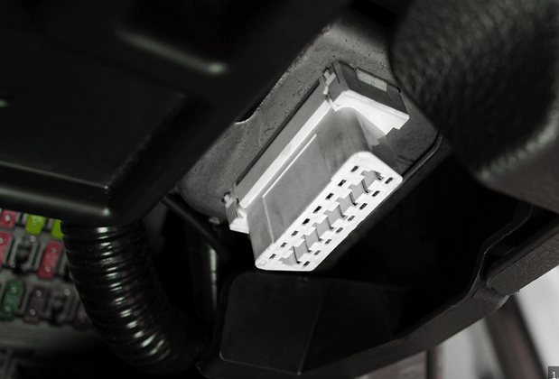
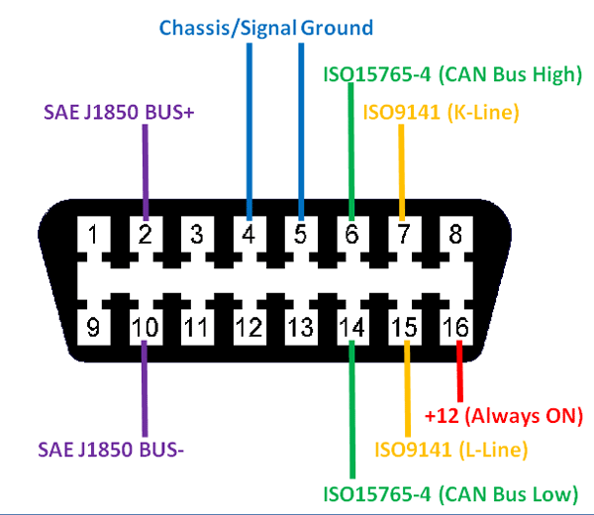
ECU diagnostic interface (OBD-II)

Slide 7
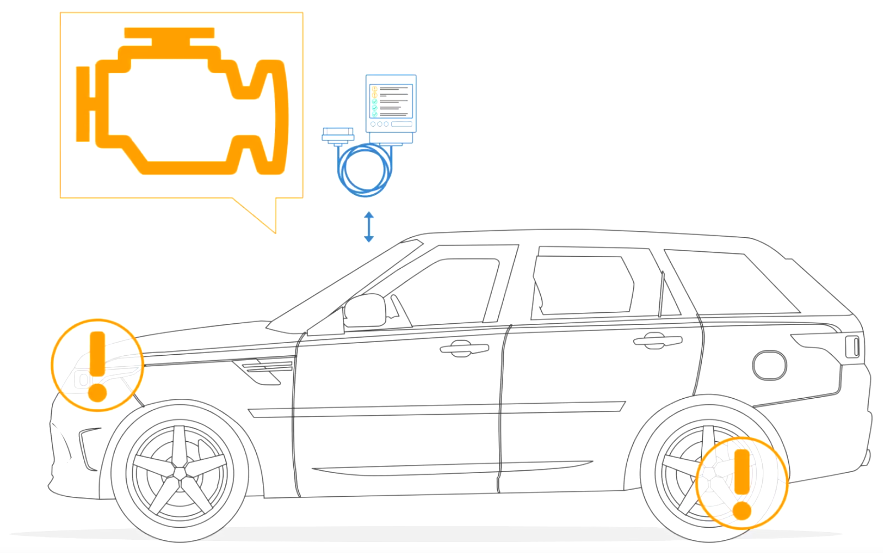
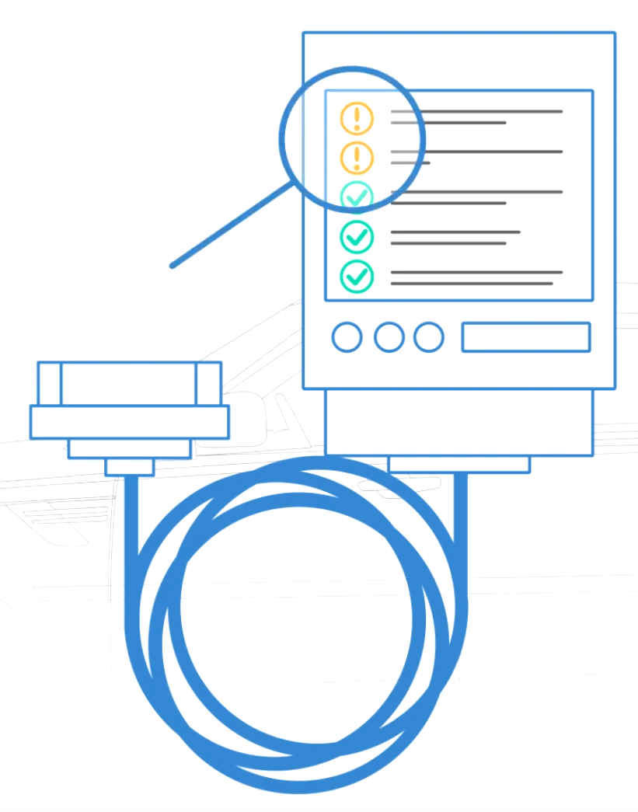
Basics of OBD2

Slide 8
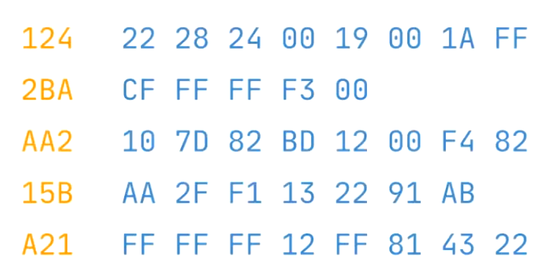
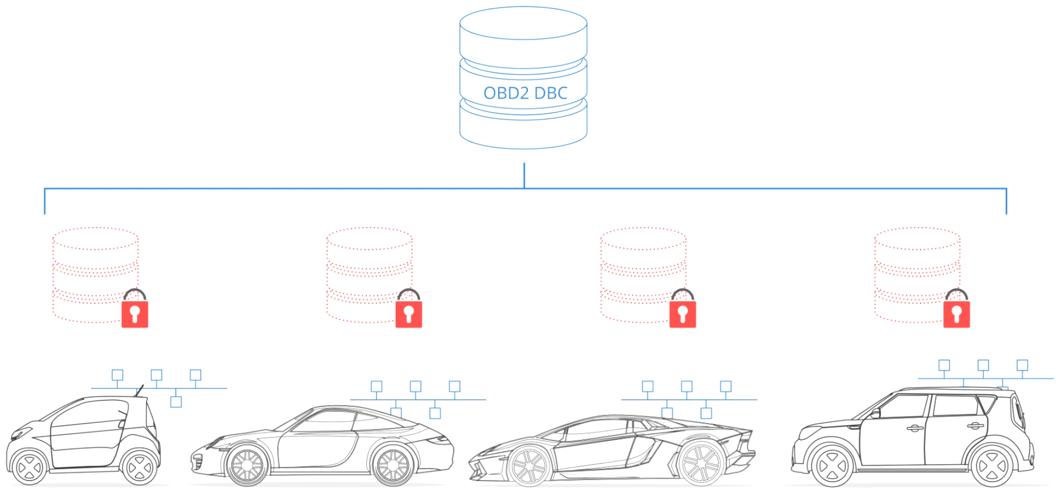
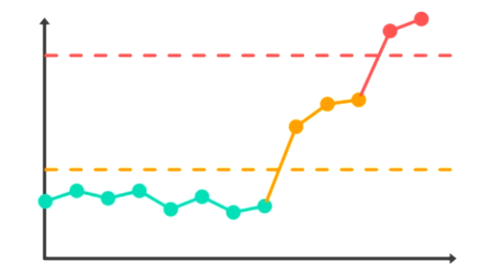
Car Parameter and diagnostic

Slide 9
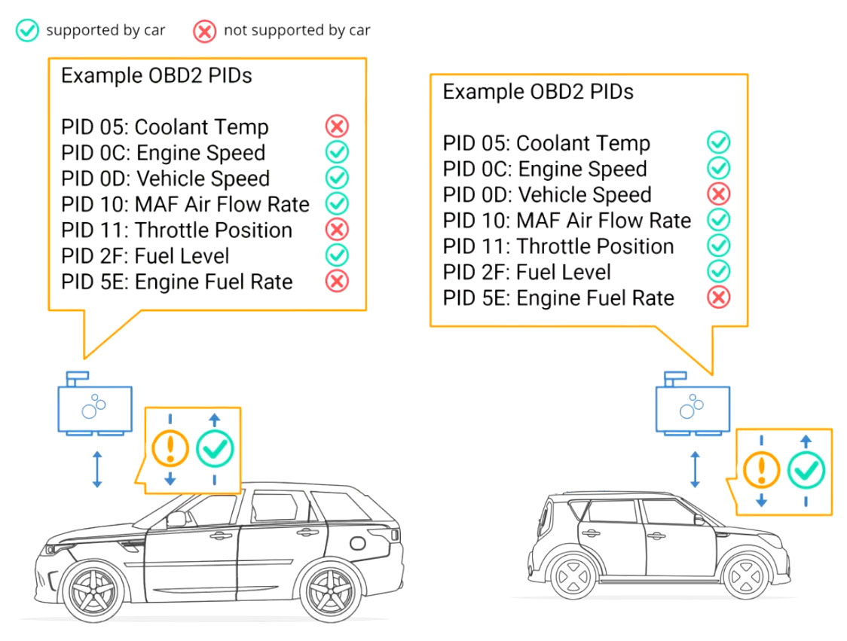
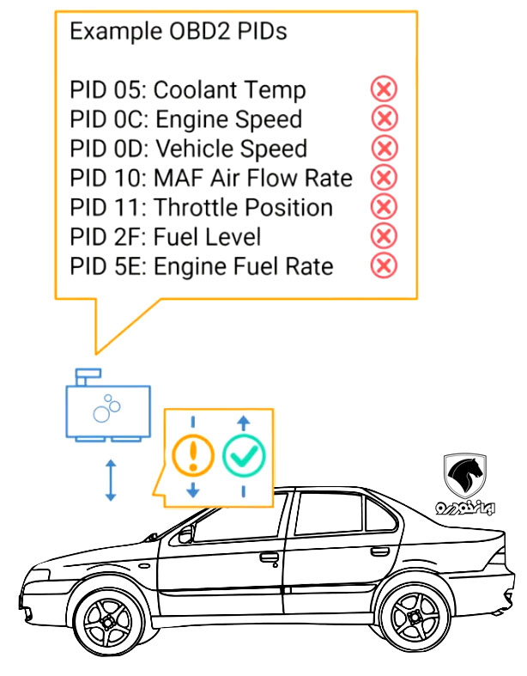
Iranian car don't use Standard PIDs

Slide 10
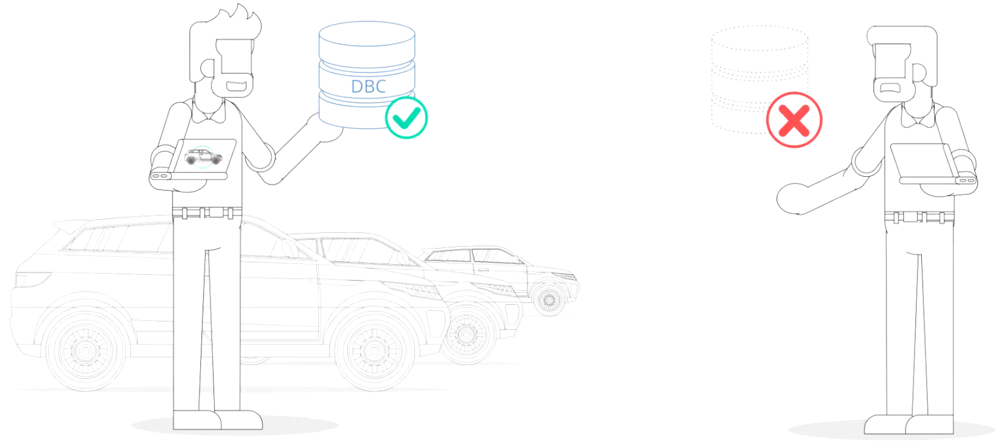
Companies don't sell this Data

Slide 11
How can we access to PIDs
?

Slide 12
It’s Easy Use SiCar Of Sisoog
Open Source ECU Reference
https://ecu.sisoog.com
We Published
40 Company
150 Car ECU Data

Slide 13
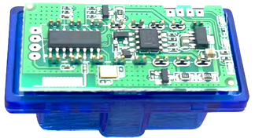
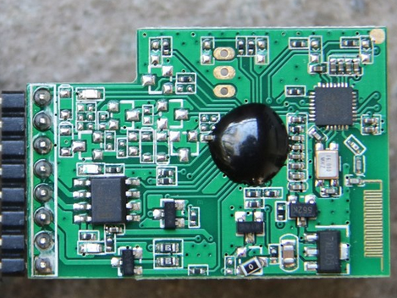
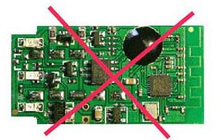
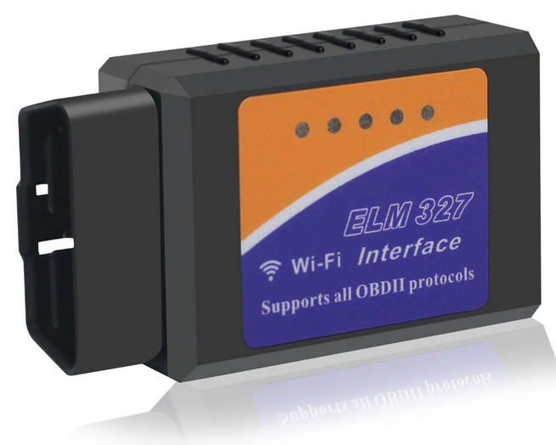
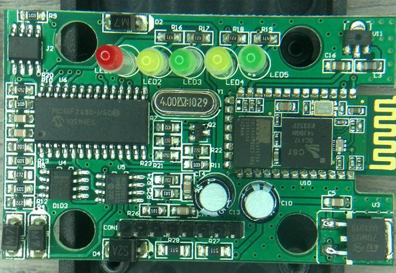
0x00 : You need hardware

Slide 14
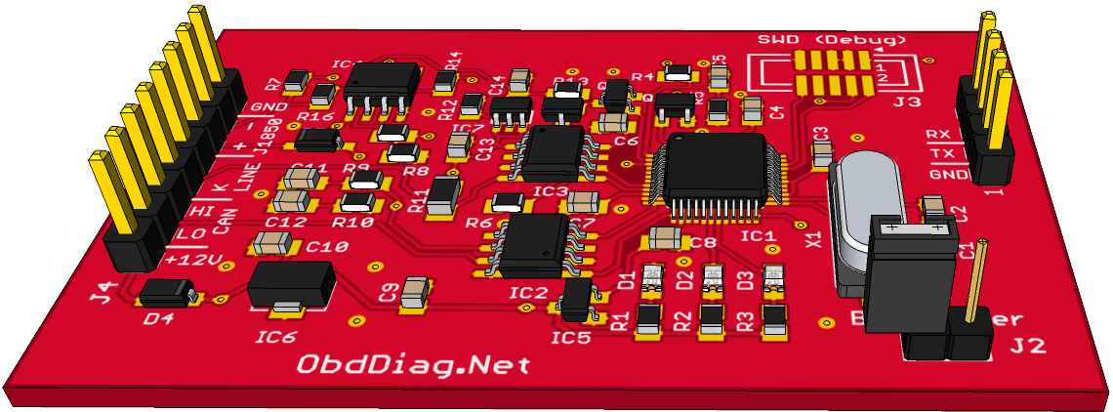
0xFF : We Like Open hardware
https://github.com/Sisoog/open-elm327

Slide 15
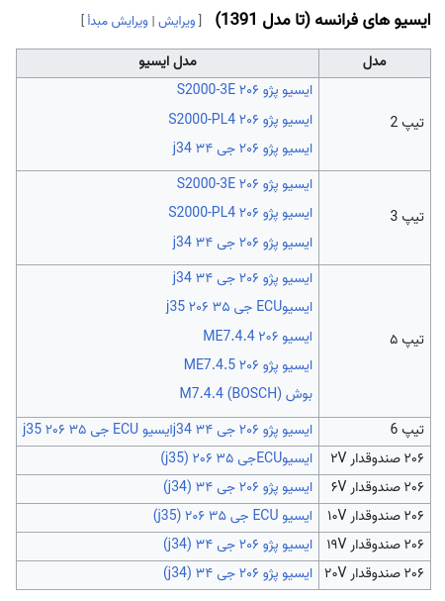
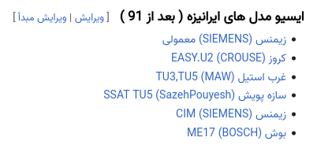
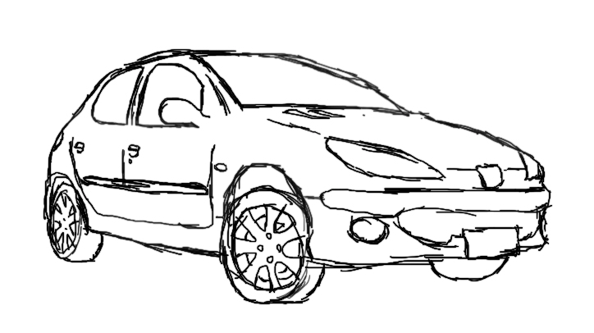
0x01 : You need know your ecu

Slide 16
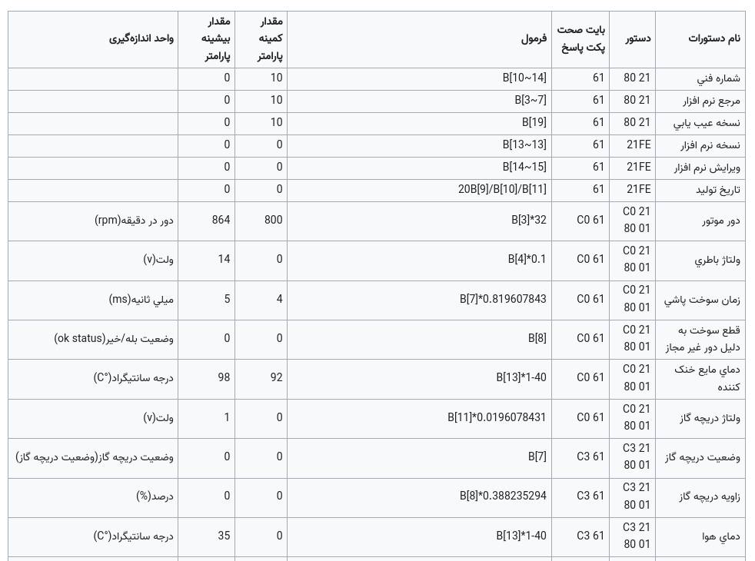
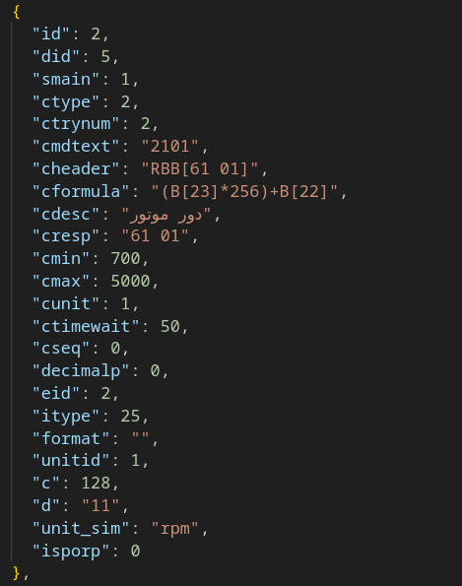
0x02 : Download your ECU PID’s File

Slide 17
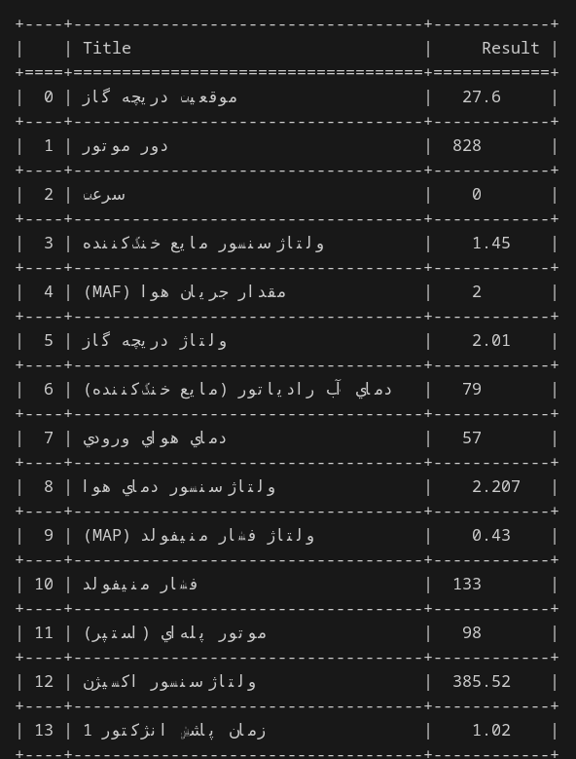
0x03 : Use Sicar-Diag

Slide 18
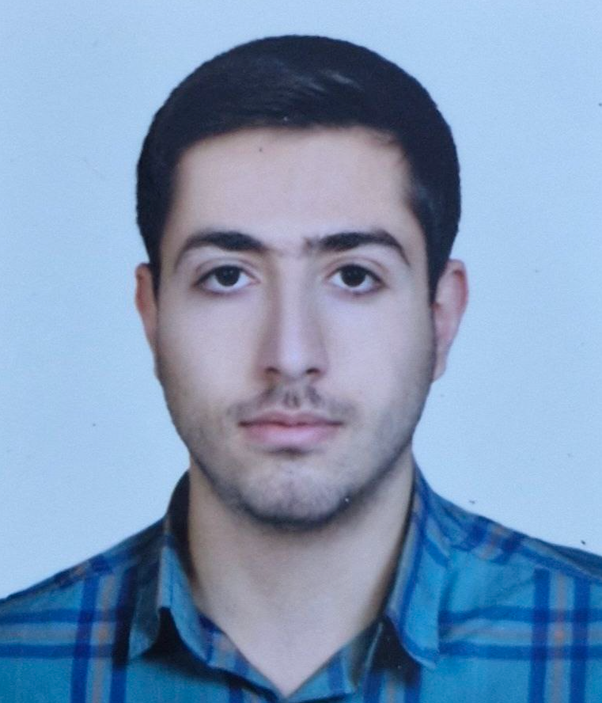
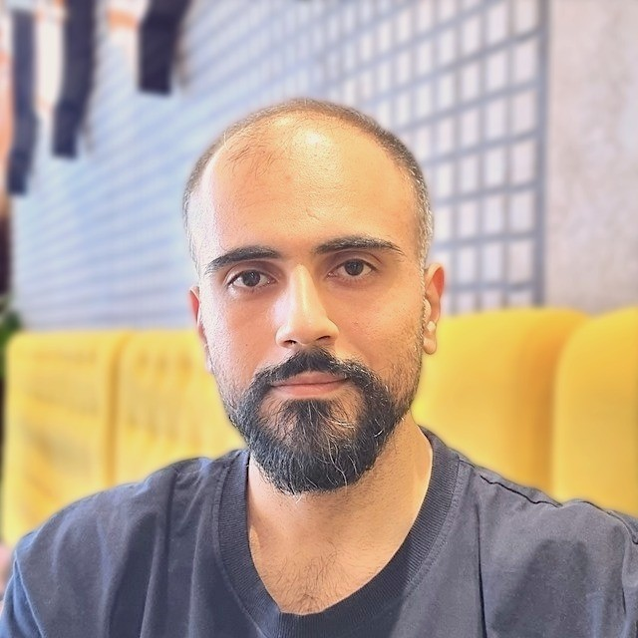
SiCar is team work :)
Mahid Ghorbanian
Mahdi Hamze
Ali Eshtehari Pour
Amir Anari
Maryam Mirian

Slide 19
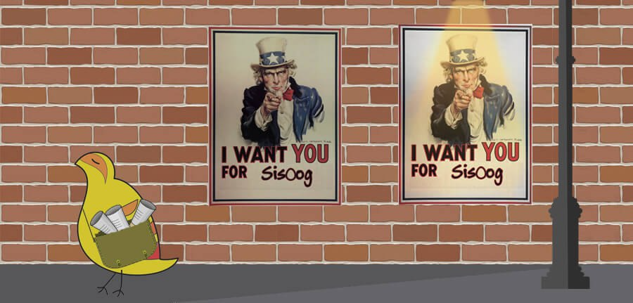
SiCar is Wiki

Slide 20
Thank you
Twitter.com/sisoog
t.me/sisoog
zeus@sisoog.com
SiCar
Www.sisoog.com
12

